Slide 1

How to perform the 5 daily Salah
By MoJ Muslim Network
Final V.3
1

Slide 2
Please open the PowerPoint via the desktop app and not the browser. If you notice any layout issues then try using presenter view.
Note
2

Slide 3
Agenda
Introduction
Importance of Intention
Guidance on how to perform Wudu step by step
Guidance on how to perform Salah step by step
Optional Acts / Activities / Glossary
Dua’s (In Arabic with English Transliteration and Translation)
Reference
Contact details
3

Slide 4

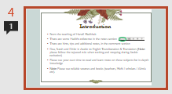
Introduction
From the teaching of Hanafi Madhhab (Book used: Ta’leemul Haq by Shabbir Ahmed E. Desai. See reference slide for full details).
There are some Hadiths reference in the notes section
There are hints, tips and additional notes, in the comment section
Dua, Surah and Dhikr in Arabic with English Transliteration & Translation (Note: please follow the tajweed rule when reciting and stopping during Arabic recitation)
Please use your own time to read and learn more on these subjects for in-depth knowledge
Note: Please use reliable sources and books (Teachers, Mufti / Scholars / Alim/a etc).
4
Notes:
It was narrated that Thawban (Radeyallahu Anha (RA) said: "The Messenger of Allah (ﷺ) said: ‘”Adhere to righteousness even though you will not be able to do all acts of virtue. Know that the best of your deeds is Salat (prayer) and that no one maintains his ablution except a believer.’” Reference: Sunan Ibn Majah 277

Slide 5
Umar bin Al-Khattab Radeyallahu Anhu (RA) narrated: The Messenger of Allah (ﷺ) said, “O people! The reward of deeds depends upon the intentions, and every person will get the reward according to what he has intended. So, whoever emigrated for Allah and His Apostle, then his emigration was for Allah and His Apostle, and whoever emigrated to take worldly benefit or for a woman to marry, then his emigration was for what he emigrated for.” [Sahih al-Bukhari]
“
”
5

Slide 6






Intention
One is rewarded for their intention. Ensure your intentions are heavy for the Mizan (scale).
Intention
For example; making an intention to be in the condition of wudu throughout the day, to pray at the prescribed time and to pray the total units for that prayer, e.g. 12 units for Zuhr.
Intention
Renew your intention each day to ensure it is not been diverted to worldly benefits.
6
Notes:
Abdullah bin 'Abbas (RA) reported: Messenger of Allah (ﷺ) ) said “Allah ordered (the appointed angels over you) that the good and the bad deeds be written, and He then showed (the way) how (to write). If somebody intends to do a good deed and he does not do it, then Allah will write for him a full good deed (in his account with Him); and if he intends to do a good deed and actually did it, then Allah will write for him (in his account) with Him (its reward equal) from ten to seven hundred times to many more times: and if somebody intended to do a bad deed and he does not do it, then Allah will write a full good deed (in his account) with Him, and if he intended to do it (a bad deed) and actually did it, then Allah will write one bad deed (in his account).” Reference: Sahih al-Bukhari 6491

Slide 7
STOP!
THINK!
What’s your intention for this learning?
7

Slide 8
What is Wudu?
You need to be in a state of purification to perform Salah
Cleanliness of the heart, mind, body and clothes is required
Purification of body is completed by partial (Wudu) or total (Bath / Ghusl) washing with clean water
In certain situations, you may require a full bath before you can perform Salah, e.g. Janaabat (major impurity, where a Ghusl / bath is compulsory)
8

Slide 9
How to perform Wudu?
“
”
9
Notes:
Abu Huraira (may Allah be pleased with him) said : "I heard the Prophet ﷺ) ) saying, "On the Day of Resurrection, my followers will be called "Al-Ghurr-ul- Muhajjalun" from the trace of ablution and whoever can increase the area of his radiance should do so (i.e. by performing ablution regularly).’ “ Reference: Sahih al-Bukhari 136
Note: Al-Ghurr-ul- Muhajjalun means, area radiance due to wudu.

Slide 10
Make the intention for Wudu in your heart “I am performing Wudu”
Start with “Bis-mil-laa-hi wal ham-du-lil-laah” (I begin with the name of Allah and all praises are due to Allah).
Note: Make Dua throughout the entire Wudu. If you’re in a bathroom with a toilet, don’t read the dua out loud (read with your mind). If you don’t know the
Arabic, you can use any language. (See an example in the comments).
Wash right hand first up to the wrist three times (x 3). Then wash left hand up to the wrist x 3.
Use a Miswaak for cleaning the teeth, as it increases salah reward by 70 times.
Gargle your mouth x 3. Note: swirl the water in your mouth thoroughly and then gargle.
Take water up to the nostrils from right palm and use left hand baby finger to clean inside x 3.
Wash the face x 3 (ear lobe to ear lobe and forehead (hairline) to below the chin). Note: For Men make Khilaal (putting your finger through) and Masah (wiping over) of the beard x 1
Wash right arm first including the elbow x 3. Then wash left arm including the elbow x 3.
10
Notes:
Abu Huraira (RA) narrated, the Prophet (ﷺ) said: “Were I not afraid that it would be hard on my followers, I would order them to use the siwak (as obligatory, for cleaning the teeth)” Reference: Sahih al-Bukhari 7240
A'isha (RA) reported God’s messenger as saying, “The prayer before which the tooth-stick is used is seventy times more excellent than that before which it is not used.” Baihaqi transmitted it in the Shu'ab al-iman. Reference: Mishkat al-Masabih 389

Slide 11
Make khilaal of all the Fingers
(in-between). Note: right
hand first then left x 1
Make dua whilst making wudu, “Al-laa-hum-magh-fir lee zham-bee wa-was-si’ lee fee daa-ree wa baa-rik lee fee riz-qee”
(O Allah! Forgive my sins and give expansion (abundance) in my home
and grant me blessings in my sustenance).
Wet your hands and fingers, keep 3 fingers of each hand together (middle, ring and little finger) keep thumb, index fingers and palm raised, away from the head. x 1
Pass the 3 fingers from the forehead to the upper portion of the nape (back of neck) x 1
Now place the palms on the sides
of the head and bring forward, above the ears and forward to forehead (All fingers now raised) x 1
Insert front portion of the index fingers into both ears, while the inner part of thumb runs behind the ears all the way round x 1
Wipe the back of the neck with the back of the middle, ring and little fingers (bring 3 fingers of each hand together) x 1
11

Slide 12
Use left hand and wash the right foot, including the ankle x 3 and make Khilaal (use little finger of your left hand and put through in-between the toes, start with little toe of right foot) x 1.
Now wash the left foot, including the ankle x 3 and make Khilaal x 1, (finishing with little toe on left).
“…No one of you performs wudu perfectly and then says,
“Ash-hadu al-laa ilaha il-lal-lahu wahdahu la sharika lahu wa ash-hadu anna Muhammadan abduhu wa rasuluhu”
except that all eight gates of paradise will be open for you and you can choose which one to enter from.”
Reference: (at 4.09 on the video) : The Moment You Get to Jannah | Ep. 2 | #JannahSeries with Dr. Omar Suleiman (youtube.com)
Your Wudu is now complete!
12
Notes:
Umar bin Al-Khattab (RA) narrated: "The Messenger of Allah (ﷺ) said: “If one after performing ablution completely recites the following supplication: (Ash-hadu an la ilaha ill-Allahu wahdahu la sharika lahu, wa ash hadu anna Muhammadan ‘abduhu wa Rasuluhu) ‘I testify that there is no one worthy of worship but Allah, He is Alone and has no partner and Muhammad (ﷺ) ) is his slave and Messenger’, all the eight gates of Paradise will be opened for him and he may enter through any gate he wishes”. Reference: Bulugh al-Maram 57

Slide 13
Do’s and Don’ts
Take care to ensure every part including in-between the fingers and toes are washed / wet by the water. Use your hands to spread and rub water over your skin.
Keep full concentration throughout wudu as it will help with focusing in Salah.
A doubt will not break Wudu. If you remember making Wudu but cannot remember if the wudu has broken, the Wudu will be considered valid.
Do not re-do your Wudu if you have taken a shower. Wudu is valid, if the 4 fardh parts of wudu is washed, even if you didn’t have intention of Wudu.
Do not splash or waste water.
Do not talk of worldly affairs during Wudu.
Do not do Wudu against the sunnah methods, (i.e. to washing your hands, face or feet 4 or 5 times).
13
Notes:
It was narrated from 'Abdullah bin 'Amr (RA) that: The Messenger of Allah passed by Sa'd when he was performing ablution, and he said: 'What is this extravagance?' He said: 'Can there be any extravagance in ablution?' He said: 'Yes, even if you are on the bank of a flowing river.’” Reference: Sunan Ibn Majah 425

Slide 14
What breaks Wudu?
Discharging Urine, Stool
Discharging Gases
Vomiting a Mouthful
Falling asleep lying down or by resting the body against something
Fainting due to some illness or other reason
Becoming Insane or going Mad
Laughing aloud whilst in Namaz
Flowing of blood or pus from any part of the body
14

Slide 15
What is Salah?
“
It’s one of the 5 pillars of Islam
In Islam it is mandatory to offer the 5 daily Salah
”
15
Notes:
Jabir (RA) reported: Messenger of Allah (ﷺ) said, "The five daily Salat (prayers) are like a great river running by your door in which you take a bath five times a day.“ Reference: Riyad as-Salihin 429
Abu Huraira (RA) narrated: Allah's Messenger (ﷺ) ) said, "If the people knew what is the reward of making the call (for the prayer) and (of being in) the first row (in the prayer), and if they found no other way to get this privilege except by casting lots, they would certainly cast lots for it. If they knew the reward of the noon prayer, they would race for it, and if they knew the reward of the morning (i.e. Fajr) and `Isha prayers, they would present themselves for the prayer even if they had to crawl to reach there.” Reference: Sahih al-Bukhari 2689

Slide 16






Five Daily Salah
Fajr
Zuhr
Asr
Isha
Maghrib
4 Units (Raka’aat)
2 Sunnat Muakkadah
2 Fardh
12 Units
4 Sunnat Muakkadah
4 Fardh
2 Sunnat Muakkadah
2 Nafl
8 Units
4 Sunnat Ghair Muakkadah
4 Fardh
7 Units
3 Fardh
2 Sunnat Muakkadah
2 Nafl
17 Units
4 Sunnat Ghair Muakkadah
4 Fardh
2 Sunnat Muakkadah
2 Nafl
3 Witr Waajib
2 Nafl
16
Notes:
Anas bin Malik (RA) narrated: "On the Night of Isra, fifty prayers were made obligatory upon the Prophet. Then it was decreased until it was made five. Then it was called out: 'O Muhammad! Indeed My Word does not change; these five prayers will be recorded for you as fifty.’” Reference: Jami` at-Tirmidhi 213

Slide 17


Timeline
Never miss your Witr Salah.
Don’t miss the opportunities to make a dua after Salah, e.g. even if you say “Alhamdulillaah”
Fajr (Early Morning Prayer)
The two units of Fajr sunnah is better for you than this world and everything it contains.
Pray Fajr minimum 15 minutes before Sunrise
Zuhr (After Midday Prayer)
Build a house in Jannah by consistently praying the 12 units of sunnah (2 at Fajr, 4 & 2 at Zhur, 2 at Maghrib and 2 at Isa)
Asr (Late Afternoon prayer)
Always offer Salah in it’s proper time.
It’s Makrooh to read Asr 20 minutes before Sunset.
Maghrib (Evening Prayer)
Do not read Salah at...
1. Sunrise 2. Sun’s at its highest peak (Zawaal - Usually midday / always check time) 3. Sunset
Isha (Night Prayer)
17
Notes:
Aishah (RA) narrated: that Allah's Messenger (ﷺ) said: "Whoever is regular with twelve Rak'ah of Sunnah (prayer), Allah will build a house for him in Paradise: Four Rak'ah before Zuhr, two Rak'ah after it, two Rak'ah after Maghrib, two Rak'ah after Isha, and two Rak'ah before Fajr.“ Reference: Jami` at-Tirmidhi 414
Aishah (RA) reported: The Prophet (ﷺ) said, "The two Rak'ah before the dawn (Fajr) prayer are better than this world and all it contains." Reference: Riyad as-Salihin 1102
Abu’d-Darda’ (RA) reported: My friend (the Messenger of Allah)ﷺ) ) directed me to observe Saum (fasting) for three days in every month, to perform two Rak'ah (optional) Duha prayer at forenoon, and to perform the Witr prayer before going to bed. Reference: Riyad as-Salihin 1259
Ibn `Umar (RA) Narrated: Allah's Messengerﷺ) ) said, "None of you should try to pray at sunrise or sunset.“ Reference: Sahih al-Bukhari 585

Slide 18
Preparation for Salah
Wudu & Clothing
Space & Qiblah
Focus
Have wudu and wear good, clean clothing that covers your awrah
Awrah for men is below the navel to below the knees. For men jubba or trousers shouldn't overlap the ankles.
Awrah for Women must cover everything except the hands to the wrist, feet and face.
Find a clean space (optional: use a prayer mat) and be mindful not to cause inconvenience to others.
Use reliable apps or compass to find the Qiblah (direction towards the Ka‘bah in Makkah).
It’s always good to double check if possible and ask your local Mosque or people. (Wifaqul Ulama has an app that can be downloaded)
From making this intention until the end of your Salah, focus completely on praying to Allah
Stand and face the Qiblah. If you’re unable to stand due to illness or infirmity, you can pray sitting down
You can make your intention for the Salah, verbally or silently. This is done in either Arabic or your own language.
18

Slide 19
How to perform Salah? (4 units of Fajr)
“
”
19
Notes:
Narrated Jabir bin 'Abdullah (RA): The Prophetﷺ) ) said: “…The earth has been made for me (and my followers) a place for praying and something with which to perform Tayammum (to purify oneself for prayer). Therefore, anyone (of my followers) can pray (anywhere) and at any time that the Salat (prayer) is due“ Reference: Bulugh al-Maram 126
Note: Tayammum can only be performed if certain conditions are met.

Slide 20


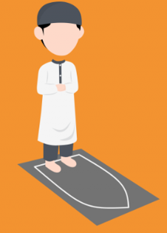
Face the Qiblah, keep feet parallel about four fingers apart with toes pointing towards the Qiblah, submit totally to Allah, and make your intention;
Raise your hands up to your ear lobes for men, and shoulders for women, (palms face towards The Qiblah) and say “Al-laa-hu Akbar”. The eyes should be fixed to the spot where the forehead will
Men should fold the hands below the navel. The palm of the right hand is placed over the back of the left hand, with the right thumb and little finger gripping the wrist of the left hand and the three middle
“I am performing (2) Rak‘at of (Sunnah) of (Fajr) to please Allah facing towards the Qiblah”
be in Prostration.
Women should place their arms on the chest. The right hand over the back of the left hand, above the breast.
fingers of the right hand kept straight and together.
20
Notes:
All images for how to pray are from the following website: How to Perform Prayer (Salah) - Noor Ul Islam

Slide 21
Read Thanaa quietly, “Sub-haa-na-kal-laa-hum-ma-wa bi ham-di-ka wa ta-baa-ra kas-muka wa-ta-‘aa-laa jad-du-ka wa laa ilaa-ha ghai-ruk’
Next read “A-oo-zhu-bil-laa-hi mi-nash-shay-taa-nir- ra-jeem”
Read “Bis-mil-laa-hir-Rah-maa-nir-Ra-heem”
Then recite Surah al-Fatihah,
“Al-hamdu-lil-laa-hi rab-bil ‘aa-la-meen. Ar-rah-maa-nir-ra-heem. Maa-li-ki-yaw-mid-deen. Iy-yaa-ka-na’-bu-du wa iy-yaa-ka nas-ta ‘een. Ih-di-nas-siraa-tal mus-ta qeem. Sira-tal-la-zhee-na an- ‘amta ‘alay-him, ghai-ril magh-duh-bi alay-him wa-ladh-dhaal-leen”
Ending by saying silently “Aameen”
Recite again “Bis-mil-laa-hir-rah-maa-nir-ra-heem” and then any other short Surah, (minimum
recitation is 3 short verses, or one long verse which is equal in length to 3 short verses). It is better to recite a complete Surah.
Throughout the prayer the surahs should follow Quranic order and go shorter in each unit than the previous. From surah Ad Dhuhaa onwards only, It's Makruh (disliked) to skip a surah. Therefore, from Ad Dhuhaa onwards read the next surah or skip two or more surahs.
21

Slide 22


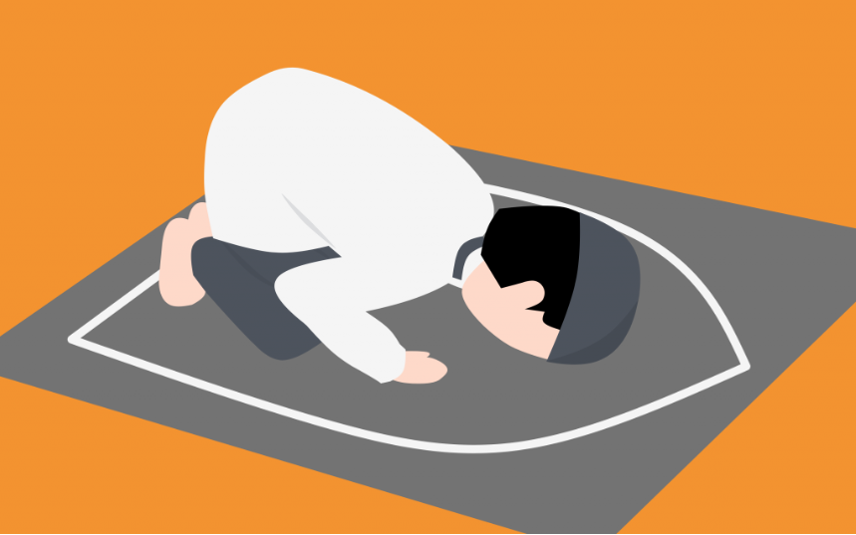
Now, bow down (Rukoo) saying “Al-laa-hu- Akbar”.
Men should hold both knees with the fingers apart, with your back straight. The head should be level with back, neither raised or lowered, and the arms should be kept away from the body.
the knees, finger kept together, and the elbows should touch the side of her body.
In your Rukoo say 3 times “Sub-haa-na rab-biyal-a-zeem”
slowly stand up fully straight, whilst
Then saying “Al-laa-hu- Akbar”, (if needed placing both hands on your knees), go into prostration (Sujud). Your knees should touch the ground first, then, palms of both hands, nose and then forehead. The face should rest between the two hands with the fingers pointing towards the Qiblah.
Women should only bend over sufficiently for her hands to reach her knees. The hands to be placed on
saying;
‘Sa-mi ‘al-laa-hu li-man ha-mi-dah’ and then say ‘Rab-ba-naa la-kal hamd”
22
Notes:
*All images for how to pray are from the following website: How to Perform Prayer (Salah) - Noor Ul Islam

Slide 23
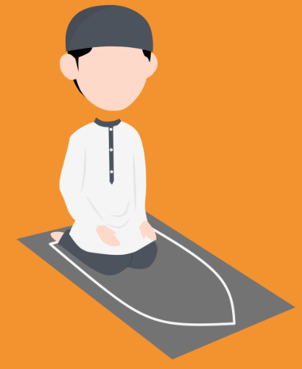
For men, in Sajud, the feet should be upright with toes pointing towards the Qiblah. The arms shouldn’t touch the ground or the side of the body, and the stomach needs to be away from the thighs.
For women, the upper part of the leg (thigh) should be as flat as possible (not upright). The stomach and thighs must be kept together, and the feet should be spread towards the right, with the toes pointing towards the Qiblah.
The forearms to be flat on the ground and close to your body.
In your Sajud say 3 times “Sub-haana rabbi-yal a‘laa”
Now sit up straight whilst saying
nose. Rest the palms of your hands on your thighs, where the tip of the fingers are near the knees. Keep the fingers together facing the Qiblah (not the ground). Also, keep your eyes on your lap.
For men, sit by resting your back on the left leg only, (keep left foot flat on the ground and sit on it), with your right foot upright and toes facing the Qiblah.
“Allahu Akbar”.
When getting up from Sujud, maintain the following order, first lift your forehead, then
23
Notes:
All images for how to pray are from the following website: How to Perform Prayer (Salah) - Noor Ul Islam

Slide 24
For women, lean on your left buttock, sit on the floor, arranging both feet to the right side, with the toes pointing towards the Qiblah.
Optional: Read once or 3 times “Rab-bigh-fir-lii”
Or, there must be a pause. After few seconds, return back into prostration whilst saying “Allahu Akbar” and then in your Sujud say 3 times “Sub- haana rabbi-yal a‘laa”
You have now completed your first unit, or Rak‘ah, of Salah.
Next, whilst saying “Allahu Akbar” stand up for the second unit.
As you're getting up from Sujud, maintain the following order, first lift your forehead, then nose, next palms and then knees. Whilst, standing up, keep your hand on your knees, do not put your hands on the ground to support yourself, unless you have valid reasons.
Follow steps 5 to 14 again
Next saying “Allahu Akbar” return to a sitting position (see step 13).
While sitting, recite the first part of the Tashahhud
“At-ta-hiy-yaa-to lil-laa-hi was-sa-la-waa tu wat-tay-yi-baa-t, as-sa-laa-mu ’a-lai-ka ay-yu-han-na-biy-yu wa-rah-ma-tul-laa-hi wa-ba-ra-kaaa-tuh. As-sa-laa-mu-’a-lay-naa wa ‘a-laa ‘I-baa-dil-laa-his saa-li-heen”.
24
Notes:
All images for how to pray are from the following website: How to Perform Prayer (Salah) - Noor Ul Islam

Slide 25

Recite “Ash-ha-du-al-laa-ilaa-ha il-lal-laa-hu wa ash-ha-du an-na Mu-ham-ma-dan ‘ab-du-hu wa ra-soo-luh”. At the words “Ash-ha-du-al-” keeping your hands on your knee, with your right hand form a circle with the thumb and middle finger
the next word “il” on top of the circle, where the top of the index finger touches the knee. Maintain the circle to the end of Tashahhud and both salaams been completed.
At the end of the second Rak‘at of the Fajr prayer, continue sitting down and recite Duroode Ibraheem; “Al-laa-hum-ma sal-li ‘a-laa Mu-ham-madiw wa ‘a-laa aa-li Muham-mad, ka-maa sal-lay-ta ‘a-laa Ibra-heema wa ‘a-laa aa-li Ibra-heema in-na-ka ha-mee-
-dum ma-jeed. Al-lah-hum-ma baa-rik ‘a-laa Mu-ham-ma diw wa ‘a-laa aa-li Muhammad, ka-maa baa-rak-ta ‘a-laa Ibraheema wa ‘a-laa aa-li Ibraheema in-naka ha-mee-dum –majeed”.
Now recite the following Dua;
“Al-laa-hum-ma in-nee za-lam-tu naf-see zul-man kasee-raa, wa laa yagh-fi-ruzh-zhu-noo-ba il-laa an-t, fagh-fir lee magh-fi-ra-tam min ‘in-dika war ham-nee in-naka an-tal gha-foo rur Raheem.”
while remaining fingers follow behind. Then, raise your index finger with the word “laa-ilaa-ha”. Then, lower your right index finger at
25
Notes:
All images for how to pray are from the following website:How to Perform Prayer (Salah) - Noor Ul Islam

Slide 26
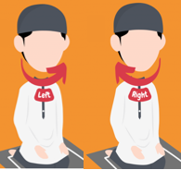


Next, keep your chest straight facing the Qiblah, turn your head, first over to your right shoulder, keep your eyes fixed on the shoulder. Your intention should be greeting the Angels.
2 units of Sunnah prayer is now complete.
Note: Now repeat step 1 to 22 for 2 rakat of Fardh. Only change here is you intention, e.g. “I am performing (2) Rak‘at of (Fardh) of (Fajr) to please Allah facing towards the Qiblah”
The numbers and text inside the brackets above needs to be replaced each time you start new units of prayer or Salah.
Optional: Once you have completed your Salah, read 3 times “Astaghfirullah”
Take the opportunity to raise your both hands to the level of your chest and make Dua.
Recite, “As-sa-laa-mu ‘a-lay-kum wa rah-ma-tul-laah.” Then turn over to left shoulder and repeat the Salaam.
Even if it’s just to say “Al-hamdu-lil-laah”.
A beautiful sunnah Dua, that is all-encompassing (for the world and hereafter) is on the Dua slide.
26
Notes:
All images for how to pray are from the following website:How to Perform Prayer (Salah) - Noor Ul Islam
Jabir bin `Abdullah (RA) narrated that : the Messenger of Allahﷺ) ) said: “The best remembrance is: ‘there is none worthy of worship except Allah (Lā ilāha illallāh)’ and the best supplication is: ‘All praise is due to Allah (Al-ḥamdulillāh).’” Reference: Jami` at-Tirmidhi 3383

Slide 27
How to perform the other units of Salah?
“
”
4 units of Sunnah
3 and 4 units of Fardh
3 units of Waajib
2 units of Nafal
27

Slide 28
To perform 4 rakat of sunnah, follow the steps 1 to 19.
Next, stand up for 3rd and 4th rakat, whilst saying “Allahu Akbar” and follow the steps 5 to 22.
To perform 3 or 4 rakat of Fardh, Everything is almost same as step 23 to 24, except, no other Surah should be added after surah Fatihah on the 3rd and 4th rakat and go straight into Rukoo. If you’re reading 3 rakats, after the Sujuds
follow, steps 17 to 22 to complete the 3 units of Fardh Salah.
To perform 3 rakat of Waajib (Witr Salah), read as normal up to the 3rd rakat. On the 3rd rakat after reciting Bismillah, Surah Fatihah and a Surah...
Say “Allahu Akbar” raise hands up to the ear lobes (Men) or shoulder (Women) and fold the hands back to the Navel (Men) or chest (Women). (See step 2 for details).
Recite Dua Qunoot;
“Allāhumma innā nastaʿīnuka wa nastaghfiruka wa nu’minu bika wa nuthnī ʿalayka-l-khayr, wa lā nakfuruka wa naklaʿu wa natruku may-yafjuruk, Allāhumma iyyāka naʿbudu wa laka nuṣallī wa nasjud, wa ilayka nasʿā wa naḥfid, narjū raḥmatak, wa nakhshā ʿadhābak, inna ʿadhābaka-l-jidda bi-l-kuffāri mulḥiq.”
28

Slide 29

Next, follow the steps 8 to 14.
Then, follow steps 17 to 22 and complete your 3 units of Witr Salah.
To perform 2 rakat of Nafal, the steps are same as the 2 units of Sunnah prayer, except, your intention will be to pray Nafl.
Note: The next few steps are few optional acts, that can be completed after each of the five
daily Salah. Build on them slowly from where you are at your personal level and do not try and do too much at once.
Optional; Read Astaghfirullah (I seek forgiveness from Allah) x 3.
Slide 31 has more Opportunities & Optional Acts.
Make dua;
e.g. Rabbana atina fi-dunya hasanatan (our Rabb grant us goodness in this world) Wafil-akhirati hasanatan (and goodness in the hereafter)Waqina adhaban-nar (and protect us from the punishment of the fire). Reference: Surah Al Baqara: Ayah 201.
If you don’t know the Arabic duas, while you’re learning, you can say the duas verbally in any language, let it come from your heart!
29
Notes:
Anas (RA) reported: The supplication most often recited by the Prophetﷺ) ) was: "Allahumma atina fid-dunya hasanatan, wa fil-akhirati hasanatan, wa qina 'adhab-annar (O our Rubb! give us in this world that which is good and in the Hereafter that which is good and save us from the punishment of the Fire).” Reference: Riyad as-Salihin 1467

Slide 30
The next few slides will cover optional acts and opportunities after Salah. Please remember… - You Do not have to achieve everything at once - Start with one habit, once you’re consistent and it becomes natural and easy, In Sha Allah work on the next habit (this works with any goals).
“
”
30
Notes:
Abu Hurairah (RA) narrated that the Messenger of Allah ﷺ) ) said: “Take on only as much as you can do of good deeds, for the best of deeds is that which is done consistently, even if it is little.” Reference: Sunan Ibn Majah 4240
Abu Hurairah (RA) reported: The Messenger of Allahﷺ) ) said, "The angels supplicate in favour of one of you so long as he remains in the place where he has performed Salat (prayer) in a state of Wudu'. They (the angels) say: 'O Allah! Forgive him, O Allah! Have mercy on him.“ Reference: Riyad as-Salihin 1062

Slide 31
Opportunities & Optional Acts
Read with the intention of Quran and Dua for protection
After Fajr read 3 times
After every Fardh Salah read
Read once after every Fardh Salah, except three times after Fajr and Maghrib Salah
Aayatul kursee
Sura Al-Ikhlas
Sura Al-Falaq
Sura An-Nas
Subhan-Allahi wa Bihamdihi (Glory be to Allah and praise be to You)
Adada Khalqihi (Equivalent to the number of His creation)
Wa rida nafsihi (until He is pleased)
Wa zinatah arshihi (To the weight of His throne)
Wa midada kalimatihi (Equivalent to His infinite words).
Sub-haa-nal-laah (Glory be to Allah), read 33 times
Al-ham-du-lil-laah (All praise be to Allah), read 33 times
Al-laahu Akbar (Allah is the greatest), read 34 times
Or read them 10 times each
Add Laa-ilaaha il-lal-laah or Laa-ilaaha il-lal-laahu Muhammadur rasoo-lul-laah (ﷺ) to your dhikr.
31
Notes:
Narrated Abu Umamah (RA): Allah's Messengerﷺ) ) said: "Whoever recites Ayat al-Kursi at the end of every obligatory prayer, nothing but death will prevent him from entering Paradise." Reference: Hadith - The Book of Prayer - Bulugh al-Maram (An-Nasa'i reported it, and Ibn Hibban graded it Sahih (authentic).
Abdullah bin Khubaib (RA) reported: The Messenger of Allahﷺ) ) said to me, "Recite Surat Al-Ikhlas and Al- Mu'awwidhatain (Surat Al-Falaq and Surat An-Nas) three times at dawn and dusk. It will suffice you in all respects.“ Reference: Riyad as-Salihin 1456
Aisha (RA) narrated: “Whenever Allah's Messengerﷺ) ) went to bed, he used to recite Surat-al-Ikhlas, Surat-al-Falaq and Surat-an- Nas and then blow on his palms and pass them over his face and those parts of his body that his hands could reach. And when he fell ill, he used to order me to do like that for him.” Reference: Sahih al-Bukhari 5748
Juwairiyah bint Al-Harith (RA), the Mother of the Believers, reported: The Prophetﷺ) ) came out from my apartment in the morning as I was busy in performing the dawn prayer. He came back in the forenoon and found me sitting there. The Prophet (ﷺ) ) said, "Are you still in the same position as I left you." I replied in the affirmative. Thereupon the Prophet said, "I recited four words three times after I had left you. If these are to be weighed against all you have recited since morning, these will be heavier. These are: Subhan-Allahi wa bihamdihi, `adada khalqihi, wa rida nafsihi, wa zinatah `arshihi, wa midada kalimatihi [Allah is free from imperfection and I begin with His praise, as many times as the number of His creatures, in accordance with His Good Pleasure, equal to the weight of His Throne and equal to the ink that may be used in recording the words (for His Praise)].“ Reference: Riyad as-Salihin 1433
Ka'b bin 'Ujrah (RA) reported: The Messenger of Allahﷺ) ) said, "There are some words, the reciters of which will never be disappointed. These are: Tasbih [saying 'Subhan-Allah' (Allah is free from imperfection)], thirty-three times, Tahmid [saying 'Al-hamdu lillah' (praise be to Allah)] thirty-three times and Takbir [saying 'Allahu Akbar' (Allah is Greatest)] thirty-four times; and these should be recited after the conclusion of every prescribed prayer.“ Reference: Riyad as-Salihin 1420

Slide 32
Top 3 tips for focusing in Salah
Disconnect​ from worldly life and tasks
Slow down​ / Do not rush​
Learn the meanings
Clear your mind (or you’ll spend half of your Salah time trying to concentrate)
Sit down and read Dhikr 2 to 3 minutes before starting your Salah
Think about the meaning​ of what you’re reading.
Take your time don’t rush​.
Did you know Sujud is on of the easiest way for “your head to be lower than your heart” so it can easily pump blood to your head​
Learn the meaning of what you are reciting in Salah​
​Start small, e.g. meaning of what you’re reciting in;​
Rukoo ​
Sujud​
Surah Fatihah
Now, slowly learn the meaning of everything you’re reciting in Salah.
32

Slide 33
Do’s and Don’ts
Keep your eyes in the place of Sujud while standing, at the toes in Rukoo, towards the lap while sitting down and at the shoulders when turning your head for Salaams
If you make mistakes with the Waajib acts in Salah, then perform Sajdah Sahw (Sujud done for mistakes unknowingly); on the last rakat after Tashahud make salaam to the right only and perform two Sujud and then recite Tashahud, Durood, dua and salaams to complete your namaz
Do not talk in Salah knowing or unknowingly, e.g. replying to Salaam (breaks salah)
Do not fidget or play with clothes etc (Makrooh)
Do not recite Quran by looking at Text (breaks salah)
Do not make noise e.g. “AAH” or “OH” in pain (breaks salah)
Do not laugh aloud in Salah (breaks salah & wudu)
Do not continue to perform Salah if you have the urge to urinate or pass stool (Makrooh)
33

Slide 34


Activities 1of 2
Wudu &
Water
Use a container or a small bottle to make wudu and try not to waste water. Add additional intentions, e.g.
Intention of
Wudu
for 24 hours
Get into to the habit of making Wudu when showering or having a bath.
Go to bed and sleep with Wudu.
I am following the sunnah.
I don’t want to be wasteful and I’m doing this to be obedient and please Allah (SWT).
Top Tip – start with one habit, once you’re consistent and it becomes natural and easy, In Sha Allah work on the next habit (This works with any goals). Do not try and achieve everything at once.
Have Wudu before you set out for the day.
In Sha Allah I will extend this and not be wasteful with other things, general tap water, food, time, clothes etc.
34
Notes:
It was narrated from 'Abdullah bin 'Amr (RA) that: The Messenger of Allah (ﷺ) passed by Sa'd when he was performing ablution, and he said: 'What is this extravagance?' He said: 'Can there be any extravagance in ablution?' He said: 'Yes, even if you are on the bank of a flowing river.’” Reference: Sunan Ibn Majah 425
It was narrated that `Uthman bin `Affan (RA) said: The Messenger of Allah (ﷺ)said: “Whoever does wudoo` and does wudoo’ well, his sins come out of his body, even from beneath his nails.” Reference: Musnad Ahmad 476

Slide 35
Activities 2 of 2
Dua &
Deeds
Learn the Dua after Wudu that opens the doors to 8 gates to Paradise and reflect on the meaning of what you are reciting each time.
Learn about
Other Sunnah
Salah & it’s Rewards
Planning is key - wake up for Tahajjud over the weekend. Make intention of building this to praying every day in Ramadan and extend your intention to pray throughout the year In Sha Allah (don’t forget you get rewarded for your intentions, even if you didn’t achieve the goal).
Keep the Ummah in your duas! When you make Dua for others the Angels make Dua for you!!!
Try to keep your deeds between you and Allah. (i.e. Tahajjud prayer, charity, voluntary fasts).
Tahajjud is a powerful prayer. Wake up a little early and pray before Fajr starts, take the opportunity to talk to Allah.
35
Notes:
Narrated Jundub (RA): The Prophetﷺ) ) said, "He who lets the people hear of his good deeds intentionally, to win their praise, Allah will let the people know his real intention (on the Day of Resurrection), and he who does good things in public to show off and win the praise of the people, Allah will disclose his real intention (and humiliate him).” Reference: Sahih al-Bukhari 6499
Abud-Darda’ (RA) reported: The Messenger of Allahﷺ) ) said, "The supplication of a Muslim for his (Muslim) brother in his absence will certainly be answered. Everytime he makes a supplication for good for his brother, the angel appointed for this particular task says: 'Ameen! May it be for you, too’.” Reference: Riyad as-Salihin 1495
Narrated Abu Huraira (RA): Allah's Messenger (ﷺ) said, "Our Lord, the Blessed, the Superior, comes every night down on the nearest Heaven to us when the last third of the night remains, saying: "Is there anyone to invoke Me, so that I may respond to invocation? Is there anyone to ask Me, so that I may grant him his request? Is there anyone seeking My forgiveness, so that I may forgive him?“ Reference: Sahih al-Bukhari 1145

Slide 36
Glossary 1 of 2
Terminology from Wudu
Terminology Other
Wudu – ablution / ritual washing
Miswaak – a type of twig to clean teeth
Khilaal – to put your finger through
Masah – Wipe
Dua – Supplication / personal invocation to call out and ask Allah (SWT) for your needs and wants
ﷺ
Radeyallahu Anhu (him) / Anha (her) (RA) – May Allah be please with him / her
Subhanahu Wa Ta’ala (SWT) – Glorious and Exalted is He.
Sallallahu-Alaihi-Wa-Sallam (SAW)
Peace and blessings of Allah be upon Him.
عَلَيْهِ ٱلسَّلَامُ
Alayhi Wa-Sallam (AS)
May Allah’s peace be upon Him
36
Notes:
Anas bin Malik (RA) said: "The Messenger of Allah (ﷺ) said: "Whoever sends salat upon me once, Allah (SWT) will send salat upon him tenfold, and will erase ten sins from him, and will raise him ten degrees in status.“ Reference: Sunan an-Nasa'i 1297
It was narrated from Abdullah bin Abi Talhah (RA), from his father, that: The Messenger of Allahﷺ) ) came one day with a joyful expression on his face. He said: "Jibril came to me and said: 'Will it not please you, O Muhammad, (to know) that no one of your Ummah will send salat upon you but I will send salat upon him tenfold, and no one will send salams upon you but I will send salams upon him tenfold?“ Reference: Sunan an-Nasa'i 1295

Slide 37
Glossary 2 of 2
Terminology from Salah
Awrah – nakedness
Salah – Prayer / Namaz
Fardh – Obligatory
Wajib – Necessary (next category after Fardh)
Sunnat Muakkadah – Strong sunnah, Salah which was continuously performed by the Prophet (SAW), almost never abandoned
Sunnat Ghair Muakkadah – Salah which Prophet (SAW), occasionally performed
Rukoo – Bowing
Qiblah – Direction of the Kaaba
Nafl – Optional
Sujud – Prostration
Dhikr – Glorifying Allah / remembrance of Allah
Makrooh – Disliked.
37

Slide 38
Dua, Surah and Dhikr from Wudu and Salah Arabic with English Transliteration and Translation. Best practice is to always learn from the Arabic text.
“
”
38

Slide 39
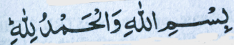
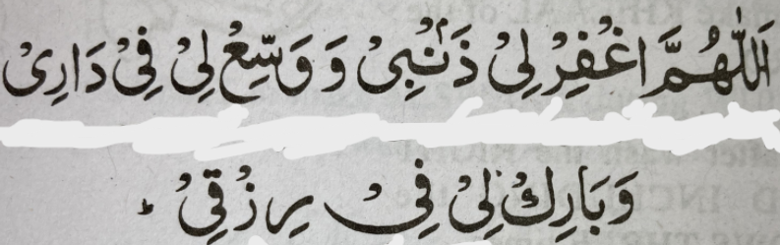
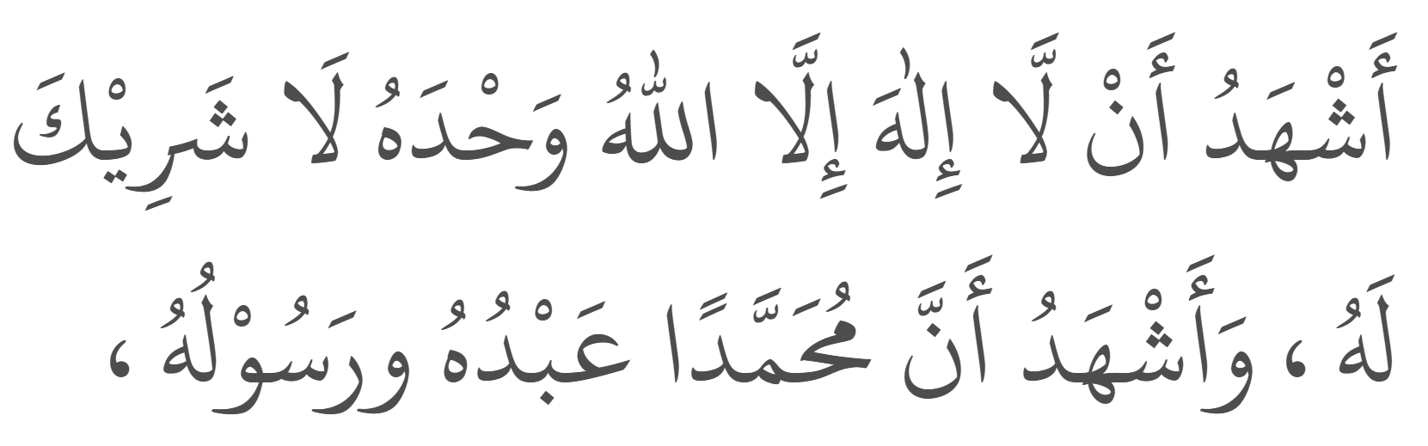
Wudu Dua’s
Arabic | Transliteration | English Translation
 | Bis-mil-laa-hi wal ham-du-lil-laah. | I begin with the name of Allah and all praises are due to Allah.
 | Al-laa-hum-magh-fir lee zham-bee wa-was-si’ lee fee daa-ree wa baa-rik lee fee riz-qee. | O Allah! Forgive my sins and give expansion (abundance) in my home and grant me blessings in my sustenance.
 | Ash-hadu al-laa ilaha illallahu Wahdahu la sharika lahu Wa ash-hadu anna Muhammadan Abduhu wa rasuluhu. | I testify that there is none worthy of worship but Allah And He is one and He has no partner And I testify that Muhammad (ﷺ -Sallallahu-Alaihi-Wa-Sallam) is His servant and His messenger.
39

Slide 40
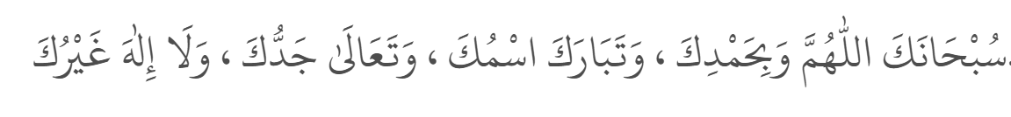
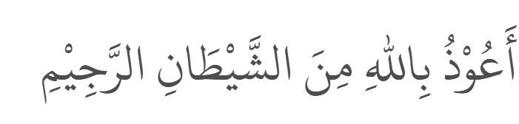
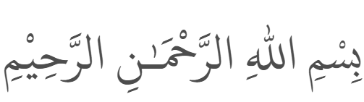
Thanaa, Ta’awwuz &Tasmiyah
Arabic | Transliteration | English Translation
 | Sub-haa-na-kal-laa-hum-ma-wa bi ham-di-ka wa ta-baa-ra kas-muka wa-ta-‘aa-laa jad-du-ka wa laa ilaa-ha ghai-ruk. | All glory be to You O Allah and praise be to You Blessed is Your name And exalted is Your Majesty And there is none worthy of worship besides You.
 | A-oo-zhu-bil-laa-hi mi-nash-shay-taa-nir- ra-jeem. | I seek refuge in Allah from Shaytaan the accursed.
 | Bis-mil-laa-hir-rah-maa-nir-ra-heem. | In the name of Allah, the most Gracious, the most Merciful.
40

Slide 41
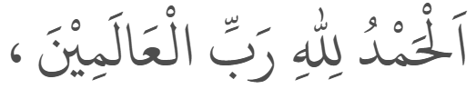
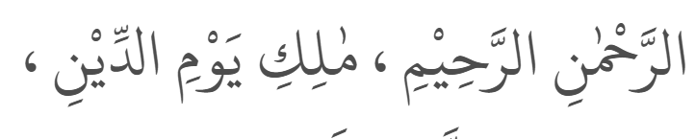
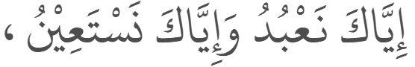
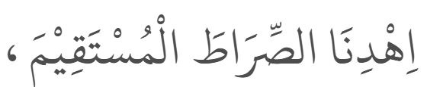
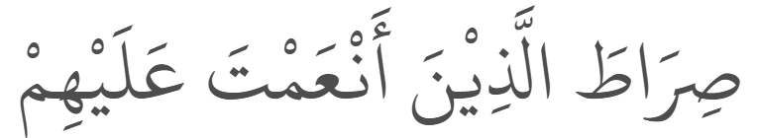
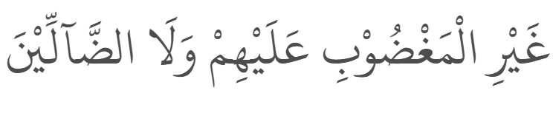
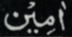
Surah al-Fatihah
Arabic | Transliteration | English Translation
 | Al-hamdu-lil-laa-hi rab-bil ‘aa-la-meen. | All praise is due to Allah, Lord of the worlds.
 | Ar-rah-maa-nir-ra-heem. | The Entirely Merciful, the Especially Merciful.
 | Maa-li-ki-yaw-mid-deen. | Sovereign (Master) of the Day of Judgement.
 | Iy-yaa-ka-na’-bu-du wa iy-yaa-ka nas-ta ‘een. | It is You we worship and You we ask for help.
 | Ih-di-nas-siraa-tal mus-ta qeem. | Guide us to the straight path,
 | Sira-tal-la-zhee-na an- ‘amta ‘alay-him, | The path of those upon whom You have bestowed favour,
 | ghai-ril magh-duh-bi alay-him wa-ladh-dhaal-leen. (say softly “Aameen”) | Not of those who have evoked Your anger or of those who are astray.
41
Notes:
It was narrated that Abu Hurairah (RA) said, 'I heard the Messenger of Allah(ﷺ) ) say’: "Allah said: 'I have divided the prayer between Myself and My slave into two halves, and My slave shall have what he has asked for. 'When the slave says: 'Al-hamdulillah i rabbil Alameen (All the praise is to Allah, the Lord of all that exists),' Allah says: 'My slave has praised Me, and My slave shall have what he has asked for.' And when he says: 'Ar-Rahmanir-Rahim (The Mos Gracious, the Most Merciful),' Allah says: 'My slave has extolled Me, and My slave shall have what he has asked for.' And when he says: 'Maliki yawmiddin [The Only Owner (and he Ruling Judge] if the Day of Recompense],' Allahs says: 'My slave has Glorified Me. This is for Me, and this Verse is between me and My slave in two halves.' And when he says: ' Iyyaka na'budu wa iyyaka nastain [You (Alone) we worship, and You (Alone) we ask for help],' He says: 'This is between Me an My slave, and My slave shall have what he has asked for.' And the end of the Surah is for My slave.' And when he says: 'Ihdinas-siratal-mustaqeema, siratal-alldhina an'amta alayhim a lad-dallin [Guide us to the Straight Way, the way of those on whom You have bestowed Your Grace, not(the way) of those who earned Your Anger, nor of those who went astray],' He says: 'THis is for My slave, and My slave shall have what he has asked for.“ Reference: Sunan Ibn Majah 3784

Slide 42
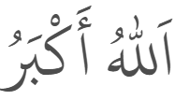

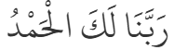
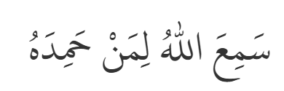
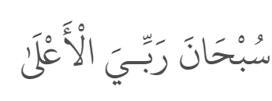
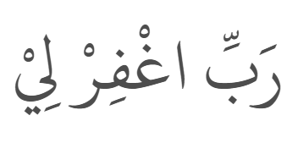
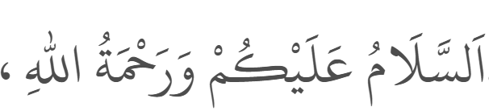
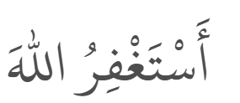
Dhikr recited in Salah
Arabic | Transliteration | English Translation
 | Al-laa-hu- akbar. | Allah is the greatest.
 | Sub-haa-na rab-biyal ‘a-zeem. | Glory to my Lord, the Great .
 | Sa-mi-‘al-laa-hu-li-man-ha-mi-dah, Rab-ba-naa la-kal hamd. | Allah has heard all who praise Him, Our Lord, Praise be to You.
 | Sub-haana rabbi-yal a‘laa. | Glory to my Lord, the Most High.
 | Rab-bigh-fir-lii. | My Lord forgive me .
 | As-sa-laa-mu ‘a-lay-kum wa rah-ma-tul-laah. | May the peace and mercy of Allah be upon you.
 | As-tagh-firul-lah. | I seek forgiveness from Allah.
42
Notes:
Abu Hurairah (RA) reported: I heard Messenger of Allah ﷺ) ) saying: "By Allah, I seek Allah's forgiveness and repent to Him more than seventy times a day.“ Reference: Riyad as-Salihin 13

Slide 43
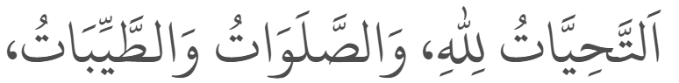
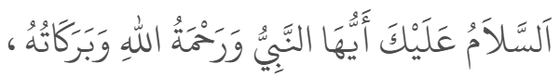
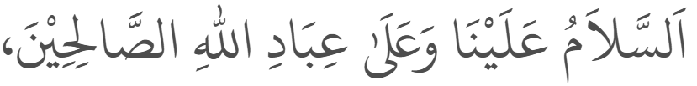
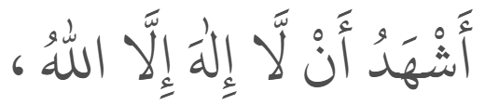
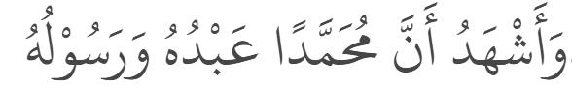
Tashahhud
Arabic | Transliteration | English Translation
 | At-ta-hiy-yaa-to lil-laa-hi was-sa-la-waa tu wat-tay-yi-baa-t, | All prayers and worship through words, action and sanctity are for Allah only
 | as-sa-laa-mu ’a-lai-ka ay-yu-han-na-biy-yu | Peace be upon you O Prophet
 | wa-rah-ma-tul-laa-hi wa-ba-ra-kaaa-tuh. | And mercy of Allah and His blessings.
 | As-sa-laa-mu-’a-lay-naa wa ‘a-laa ‘I-baa-dil-laa-his saa-li-heen. | Peace be upon us and on those who are righteous servant of Allah.
 | Ash-ha-du al-laa-ilaa-ha il-lal-laa-hu | I bear witness that none is worthy of worship besides Allah
 | wa ash-ha-du an-na Mu-ham-ma-dan ‘ab-du-hu wa ra-soo-luh. | and Muhammad is His slave and Messenger.
43

Slide 44
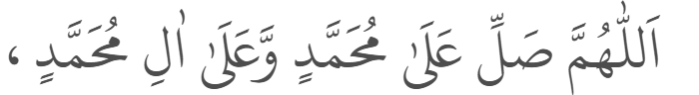
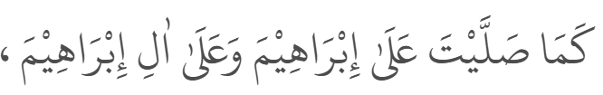
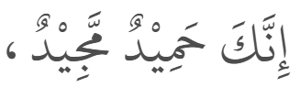
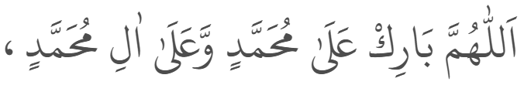
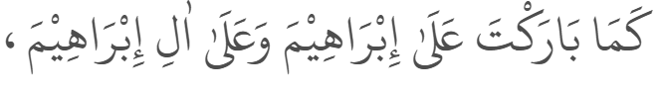
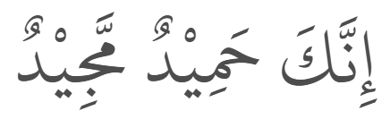
Durood
Arabic | Transliteration | English Translation
 | Al-laa-hum-ma sal-li ‘a-laa Mu-ham-madiw | O’ Allah! Shower Your mercy upon Muhammad (ﷺ)
 | wa ‘a-laa aa-li Muham-mad. | And the followers of Muhammad (ﷺ)
 | ka-maa sal-lay-ta ‘a-laa Ibra-heema | As You showered Your mercy upon Ibraheem (عَلَيْهِ ٱلسَّلَامُ)
 | wa ‘a-laa aa-li Ibra-heema | And the followers of Ibraheem (عَلَيْهِ ٱلسَّلَامُ)
 | in-na-ka ha-mee-dum ma-jeed. | Behold, You are Praiseworthy, Glorious.
 | Al-lah-hum-ma baa-rik ‘a-laa Mu-ham-ma diw | O’ Allah! Shower Your blessings upon Muhammad (ﷺ)
 | wa ‘a-laa aa-li Muhammad, | And the followers of Muhammad (ﷺ)
 | ka-maa baa-rak-ta ‘a-laa Ibraheema | As You showered Your blessings upon Ibraheem (عَلَيْهِ ٱلسَّلَامُ)
 | wa ‘a-laa aa-li Ibraheema | And the followers of Ibraheem (عَلَيْهِ ٱلسَّلَامُ)
 | in-naka ha-mee-dum –majeed. | Behold, You are Praiseworthy, Glorious.
44

Slide 45
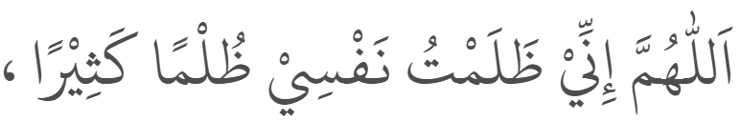
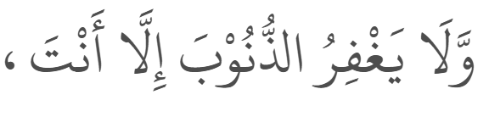
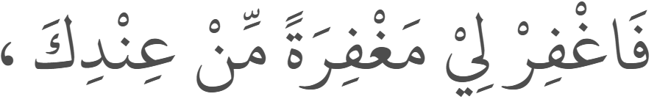
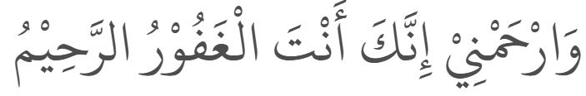
Dua after Durood
Arabic | Transliteration | English Translation
 | Al-laa-hum-ma in-nee za-lam-tu naf-see zul-man kasee-raa, | O’ Allah, I have wronged myself greatly
 | wa laa yagh-fi-ruzh-zhu-noo-ba il-laa an-t, | and no one forgives sins except You;
 | fagh-fir lee magh-fi-ra-tam min ‘in-dika | grant me forgiveness from You
 | war ham-nee in-naka an-tal gha-foo rur Raheem. | and have mercy upon me. You are the Most Forgiving, the Most Merciful.
45

Slide 46
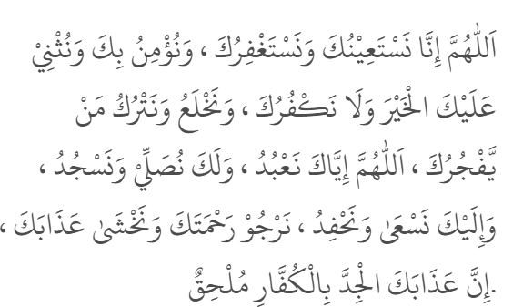
Dua-e-Qunoot
Arabic | Transliteration | English Translation
 | Allāhumma innā nastaʿīnuka wa nastaghfiruka wa nu’minu bika wa nuthnī ʿalayka-l-khayr, | O Allah, we beg You for Your help and we seek Your forgiveness. We believe in You, we praise You highly,
 | wa lā nakfuruka wa naklaʿu wa natruku may-yafjuruk, | and we are not ungrateful to You. We move away from and leave those who disobey You.
 | Allāhumma iyyāka naʿbudu wa laka nuṣallī wa nasjud, wa ilayka nasʿā wa naḥfid, | O Allah, You Alone we worship, to You Alone we pray and prostrate, to You Alone we strive and hasten.
 | narjū raḥmatak, wa nakhshā ʿadhābak, inna ʿadhābaka-l-jidda bi-l-kuffāri mulḥiq. | We hope for Your mercy and we fear Your punishment: Your severe punishment will surely be meted out to the disbelievers.
46

Slide 47
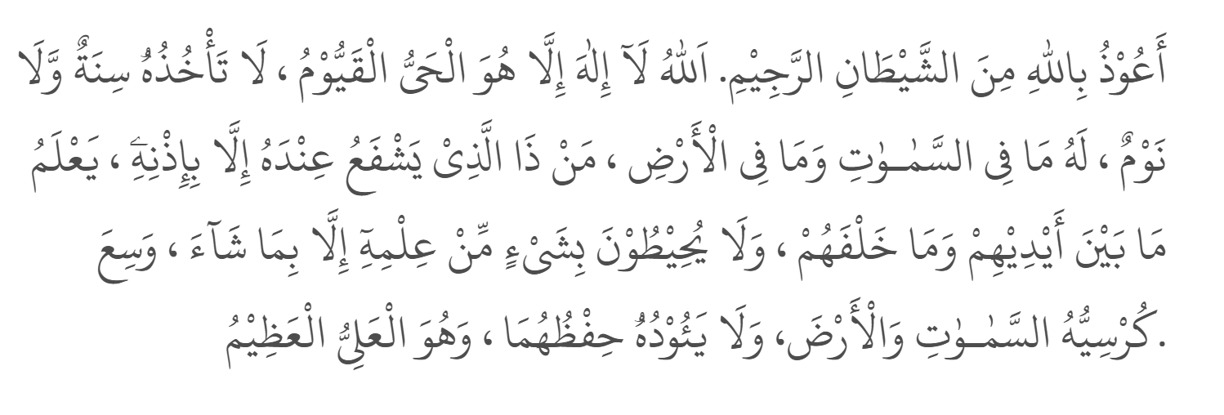
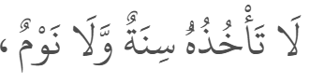
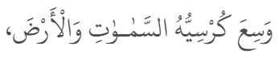
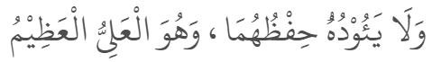
Aayatul kursee
Arabic | Transliteration | English Translation
 | Aʿūdhu bi-llāhi mina-sh-Shayṭāni-r-rajīm. Allāhu lā ilāha illā Huwa-l-Ḥayyu-l-Qayyūm, lā ta’khudhuhū sinatuw-wa lā nawm, lahū mā fi-s-samāwāti wa mā fi-l-arḍ, man dhā’lladhī yashfaʿu ʿindahū illā bi-idhnih, yaʿlamu mā bayna aydīhim wa mā khalfahum, wa lā yuḥīṭūna bi-shay’im-min ʿilmihī illā bi-mā shā’, wasiʿa kursiyyuhu-s-samāwāti wa-l-arḍ, wa lā ya’ūduhū ḥifẓuhumā wa Huwa-l-ʿAlliyu-l-ʿAẓīm. | I seek the protection of Allah from the accursed Shayṭān. Allah, there is no god worthy of worship but He, the Ever Living, The Sustainer of all. Neither drowsiness overtakes Him nor sleep. To Him Alone belongs whatever is in the heavens and whatever is on the earth. Who is it that can intercede with Him except with His permission? He knows what is before them and what will be after them, and they encompass not a thing of His knowledge except for what He wills. His Kursī extends over the heavens and the earth, and their preservation does not tire Him. And He is the Most High, the Magnificent. (2:255)
47

Slide 48
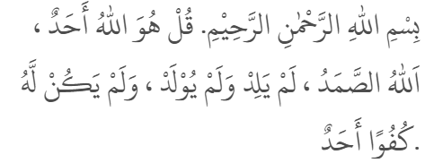
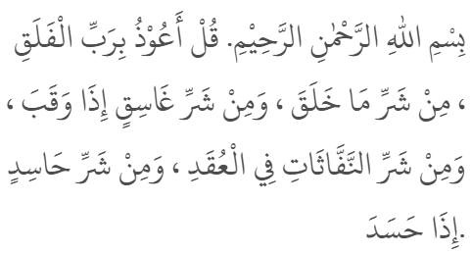
Dua for protection 1/ 2
Arabic | Transliteration | English Translation
 | Bismi-llāhi-r-Raḥmāni-r-Raḥīm. Qul Huwa-llāhu Aḥad. Allāhu-ṣ-Ṣamad. Lam yalid wa lam yūlad. Wa lam yakul-lahū kufuwan aḥad. | In the name of Allah, the All-Merciful, the Very Merciful. Say, He is Allah, the One, the Self-Sufficient Master, Who has not given birth and was not born, and to Whom no one is equal.
 | Bismi-llāhi-r-Raḥmāni-r-Raḥīm. Qul aʿūdhu bi Rabbi-l-falaq. Min sharri mā khalaq. Wa min sharri ghāsiqin idhā waqab. Wa min sharri-n-naffāthāti fi-l-ʿuqad. Wa min sharri ḥāsidin idhā ḥasad. | In the name of Allah, the All-Merciful, the Very Merciful. Say, I seek protection of the Lord of the daybreak, from the evil of what He has created, and from the evil of the darkening night when it settles, and from the evil of the blowers in knots, and from the evil of the envier when he envies.
48

Slide 49
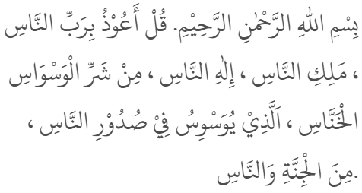
Dua for protection 2/2
Arabic | Transliteration | English Translation
 | Bismi-llāhi-r-Raḥmāni-r-Raḥīm. Qul aʿūdhu bi rabbi-n-nās. Maliki-n-nās. Ilāh-hin-nās. Min sharri-l-waswāsi-l-khannās. Al-ladhī yuwaswisu fī ṣudūri-n-nās. Mina-l-jinnati wa-n-nās. | In the name of Allah, the All-Merciful, the Very Merciful. Say, I seek protection of the Lord of mankind, the King of mankind, the God of mankind, from the evil of the whisperer who withdraws, who whispers in the hearts of mankind, whether they be Jinn or people.
49

Slide 50
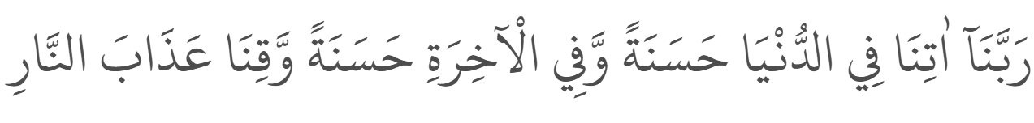
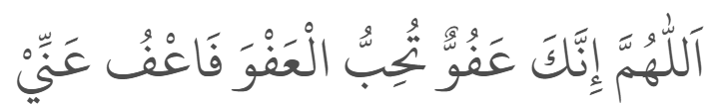





Dua’s & Dhikr 1/2
Arabic | Transliteration | English Translation
 | Rabbana atina fi-dunya hasanah, | Our Rabb grant us goodness in this world
 | Wafil-akhirati hasanah, | and goodness in the hereafter
 | Waqina adhaban-nar. | and protect us from the punishment of the fire.
 | Allahumma Innaka Afuwwun | O’ Allah You are most Forgiving
 | Tuhibbul afwa fafu anni. | You love to forgive, so forgive me.
 | Laa-ilaaha il-lal-laahu Muhammadur rasoo-lul-laah. (Sallallahu-Alaihi-Wa-Sallam) | There is none worthy of worship but Allah & Muhammad (ﷺ) is Allah’s messenger.
 | Astaghfirullah. | I seek forgiveness from Allah.
 | Allāhumma innī as’alukal-Firdawsa aʿlāl-Jannah. | O Allah, I beg you for al-Firdaws, the loftiest abode of Paradise.
 | Allāhumma ajirnī mina-n-nār | O Allah, protect me from the Hell-fire.
ﷺ
50
Notes:
Anas (RA) reported: The supplication most often recited by the Prophetﷺ) ) was: "Allahumma atina fid-dunya hasanatan, wa fil-akhirati hasanatan, wa qina 'adhab-annar (O our Rubb! give us in this world that which is good and in the Hereafter that which is good, and save us from the punishment of the Fire).” Reference: Riyad as-Salihin 1467
Mu’adh bin Jabal (RA) said: “I heard the Messenger of Allahﷺ) ) say: ‘Paradise has one hundred grades, each of which is as big as the distance between heaven and earth. The highest of them is Firdaws and the best of them is Firdaws. The Throne is above Firdaws and from it spring forth the rivers of Paradise. If you ask of Allah, ask Him for Firdaws.’” Reference: Sunan Ibn Majah 4331

Slide 51


Dua’s & Dhikr 2/2
Arabic | Transliteration | English Translation
 | Subḥāna-llāhi wa bi ḥamdih, | Allah is free from imperfection and all praise is due to Him
 | ʿadada khalqih, | (in ways) as numerous as all He has created
 | wa riḍā nafsih, | (as vast) as His pleasure
 | wa zinata ʿarshih, | (as limitless) as the weight of His Throne
 | wa midāda kalimātih. | and (as endless) as the ink of His words.
 | Subḥāna-llāh, | Allah is free from imperfection.
 | Alḥamdu li-llāh, | All praise be to Allah.
 | Allāhu akbar. | Allah is the Greatest.
51

Slide 52
Reference & Links
Book used for main content: Desai, Shabbir Ahmed E. (Soofi), (1998), Ta’leemul Haq (8th edition)
All images for how to pray are from the following website: How to Perform Prayer (Salah) - Noor Ul Islam
Dua links;
Dhikr & Du’a – Life With Allah
Dua Connect
Hadiths – All of the hadiths had been taken from https://sunnah.com. Please note, when looking on the sunnah.com website, do not take your own interpretation of hadiths. In most cases context and deeper understanding of it’s meaning is key. We must ensure we learn from our teachers (Mufti / Scholars / Alim/a etc)
52

Slide 53
Feedback / Contact MoJMuslimNetwork@Justice.gov.uk
Thank
You!
53

